Slide 1



Skynet
Big Data Analytics Proposal

Slide 2
Think Big:
Who are we?
Think Big is an
independent
pure-play
Big Data services company.

Slide 3


Think Big:
What do we do?
DATA
BUSINESS VALUE

Slide 4



Situation
Situation
Skynet supplies radios to FBOs
Future: ASD-B Transponders
Certification: $1m, 6 months per aircraft type
Identify aircrafts for certification
Identify Airlines to target
Other use cases for ADS-B data

Slide 5
Use Case 1:
Aircraft Types
Identify the top two aircraft types that have no ADS-B transponders installed.
Notes:
ARCHITECTURE
AWS cluster
Apache Hadoop
Kylo
Spark
DATA
ADS-B data: Sheldon’s antennae, ADS-B exchange, other publicly available data
DOT data: RITA
FAA data: airplane registry, certification registry
Possibly: FlightAware data, additional data sets
ANALYTICS
Markov Model
Opportunity Analysis

Slide 6
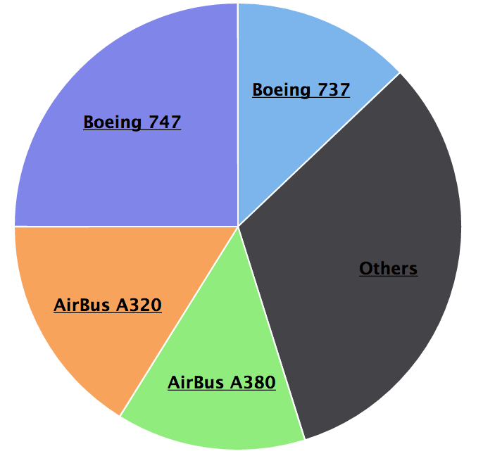
Use Case 1:
Aircraft Types
Identify the top two aircraft types that have no ADS-B transponders installed.

Slide 7
Use Case 2:
Identify airlines to target
Identify the airlines that have the most aircrafts of the chosen types

Slide 8
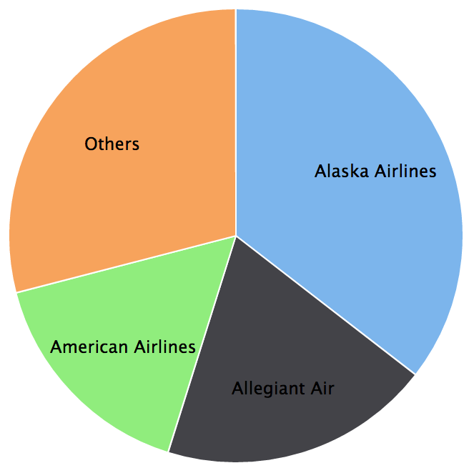
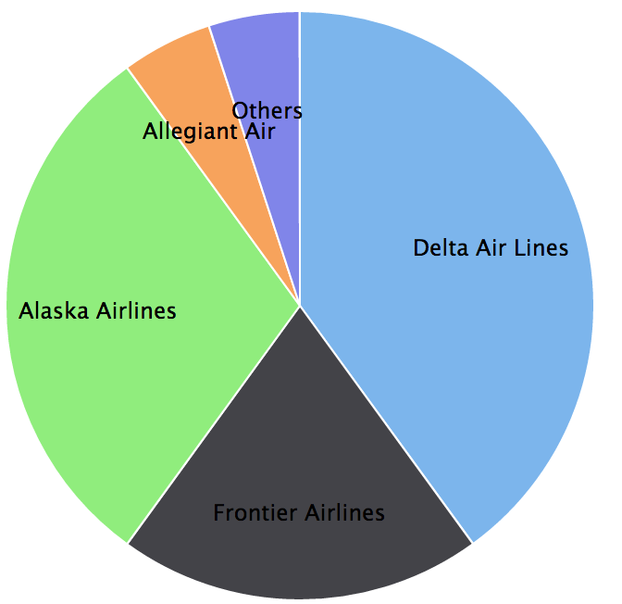
Use Case 2:
Identify airlines to target
Identify the airlines that have the most aircrafts of the chosen types
747
A320

Slide 9
Use Case 3:
Flight Status Prediction

Slide 10
Use Case 3:
Flight Status Prediction
Inform of incoming flights.

Slide 11
Use Case 3:
Flight Status Prediction
Inform of incoming flights.
Foresee future delays.

Slide 12
Use Case 3:
Flight Status Prediction
Inform of incoming flights.
Foresee future delays.
Beneficial for FBOs

Slide 13
Use Case 4:
Productionize Flight Status Prediction

Slide 14

Use Case 4:
Productionize Flight Status Prediction

Slide 15



Use Case 4:
Productionize Flight Status Prediction

Slide 16



Use Case 4:
Productionize Flight Status Prediction

Slide 17
Use Cases:
Value and Feasibility
# | Use Case |  |  | Total Value |  |  | Total Feasibility | Total Score
1 | Aircraft Type Selection | H | M-H | H | H | H | H | H
2 | Airlines Selection | H | M-H | H | H | H | H | H
3 | Flight Status Prediction | M-H | M | H | M | L | M | M
4 | Flight Status Prediction Productionisation | M | H | M | M | L | M | L
Commercial
Value
Data
Availability
Analytical
Feasibility
Competition

Slide 18
Proposed Project - 5 weeks
Data Engineers
Infra Setup
Ingestion & Prepare
Data Engineers
Validation & Visualize
Data Scientist
Presentation
Industry Consultant, All
Use Case 1 & 2
Data Gather
Data Engineers
1 week
1 week
2 weeks
1 week
Add Data Gather
Data Engineer
Add Ingest & Prepare
Data Engineer
Data Scientist
Validate & Visualize
Use Case 3 & 4

Slide 19
Fixed Price Proposal
Fixed Price:
Use Case 1 & 2 $160.000,00
Includes AWS Infra Setup
Data Acquisition Cost
Team of 2 Data Engineers, 1 Data Scientist, 1 Industry Consultant
Delta Cost Use Case 3 & 4 $40.000,00
Requires Use Case 1 & 2
Additional Data Engineer, Data Scientist

